Slide 1

Optimizing Study Management Using : A secure web application for building and managing surveys and databases
David Bard, PhD
Biomedical and Behavioral Methodology Core (ββϺC)
Department of Pediatrics, OU College of Medicine
???Research Lunch Forum???
Department of Rehabilitation Sciences, College of Allied Health
October 11, 2013

Slide 2
Presentation Outline
REDCap Overview and OUHSC History
Scenarios Favoring REDCap
Reports for Project Management
Reports for Outcomes
Overall Goals
Accessing REDCap at OUHSC
Security Practices and Policies
Citing REDCap in grants/IRB/manuscripts

Slide 3
REDCap overview (http://project-redcap.org/)
Secure web application for building and managing surveys and databases.
Developed by informatics core at Vanderbilt with support from NCRR and NIH.
Designed for academic biomedical researchers.
Provides:
A centralized, back-end storage component.
Tools to create an interactive front-end html GUI.
An API to import & export data.
Example templates.
Instructional videos for training.
User-group network of institutional researchers.
Also included: built-in project calendar, scheduling module, ad hoc reporting tools, and advanced features, such as branching logic, file uploading, and calculated fields.
It can reduce
Developing a lot of new software applications.
Anxieties related to security of home-grown software.

Slide 4
REDCap Software Features
Availability - Software available at no cost for REDCap partners.
Secure and web-based - Input data or build online survey anywhere in the world over secure web connection with authentication and data logging.
Multi-site access - REDCap databases/surveys can be used by researchers from multiple sites and institutions.

Slide 5
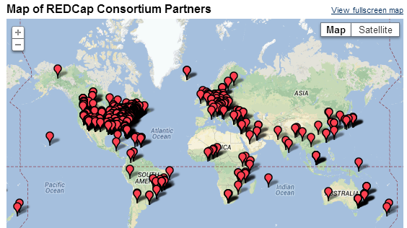
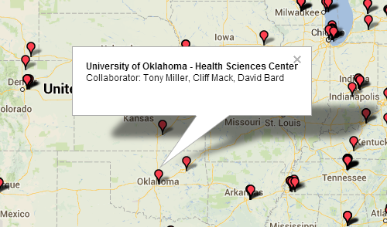
OUHSC Becomes REDCap Partner
MIECHV grant (DBP) requests REDCap (Nov. 2011)
IT installs “DBP” REDCap instance, ver.4 (Jan. 2012)
New DBP projects move to REDCap (2012-2013)
Campus REDCap interest rises (2012-2013)
IT installs “Enterprise” REDCap instance, ver.5 (Mar. 2013)
IT installs “Development box” instance, ver.5 (Apr. 2013)
Governance body requested (Mar. 2013)
Governance body formed (Jun. 2013)
Funding for REDCap admin requested (Apr. 2013)
College of Medicine agrees to fund Dev box and Enterprise instance (Jun. 2013)
REDCap freely available to all
Notes:
670 active partners in 56 countries as of June 2013
70,000 projects and 92,000 users

Slide 6
Motivation: MIECHV Collaboration
The 4 statisticians on the project. sharing software development.
The 20+ people on the project (1/3 off-site). exchanging participant-level data.
The 3 partnering organizations. (OSDH, WIC, OHCA) -receiving their subject-level & agency-level data. -distributing results –fresh & frequently.
Academics in different areas. (particularly at OUHSC) exchanging tools and workflows.
Researchers in other states pursuing similar goals. publishing ideas and replicating previous work.

Slide 7
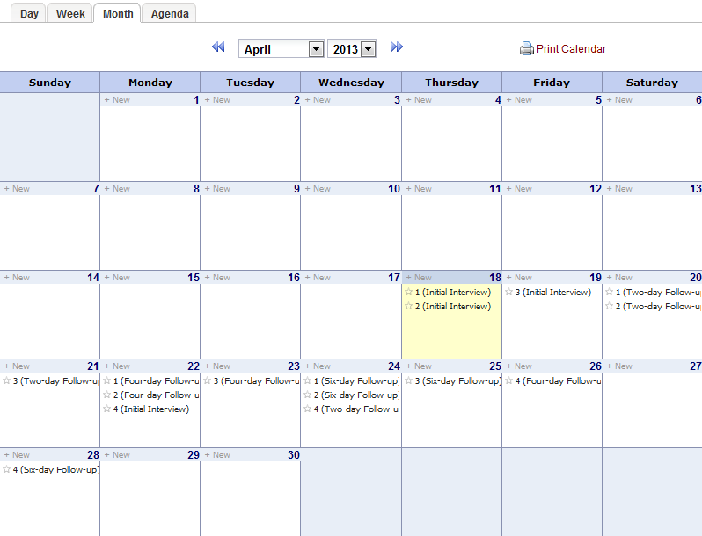
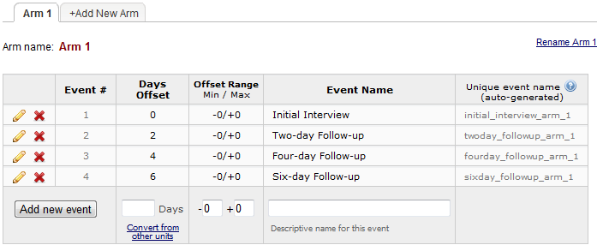
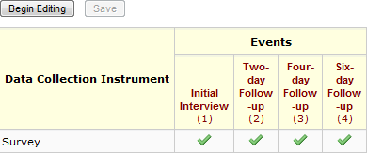
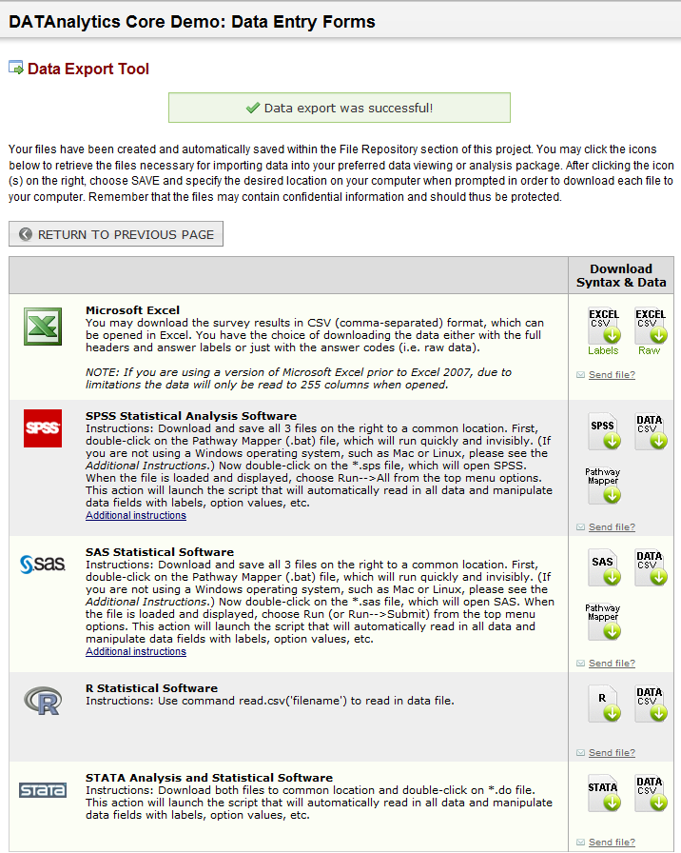
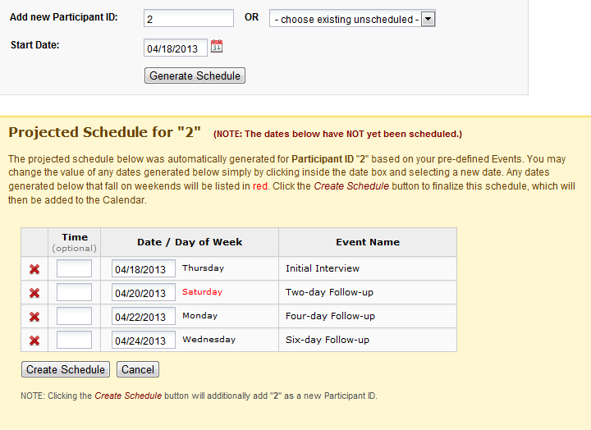
REDCap Software Highlights
Built-in project Calendar
Scheduling Module
(Define Events)
(Assign Instruments)
Built-in Export Formats
(Schedule Participant)

Slide 8
REDCap Project Types
https://redcap1.mayo.edu/redcap/index.php?action=training
Traditional Database classic model
Parent-Child Linking linking together multiple databases
Operations use case for non-study/non-trial
Longitudinal Database multi-use forms with time points

Slide 9
REDCap Front-End Data Entry
You have 2 options
Survey-based data entry
“Prettier” interface
Public and private audience options
Email tracking system
Form-based data entry
One-stop shop for data entry, scheduling, and data management
Familiar interface, resembles most form-based database software (e.g., MS Access)

Slide 10
Brief REDCap Demo
How to design a REDCap project
Online demonstrations
http://www.project-redcap.org/videos.php
Templates and demos inside each REDCap instance
REDCap google group FAQ
Survey project demo
Form project demo (cross-sectional and longitudinal)
If time permits
REDCap project for managing all research projects
Quality improvement operational database
Relational database tricks

Slide 11
Example: Survey-based Data Entry
Login to DBP REDCap (all instances use OUHSC username and password authentication)
Go to My Projects and select DataAnalytics Core Demo: Survey
Click “Open Survey” button
Click “Invite Participants” link, then “Open public survey”
Notice url
Click “Invite Participants”, then “Add participants”
Add email address then click “Send Survey Invitations”

Slide 12
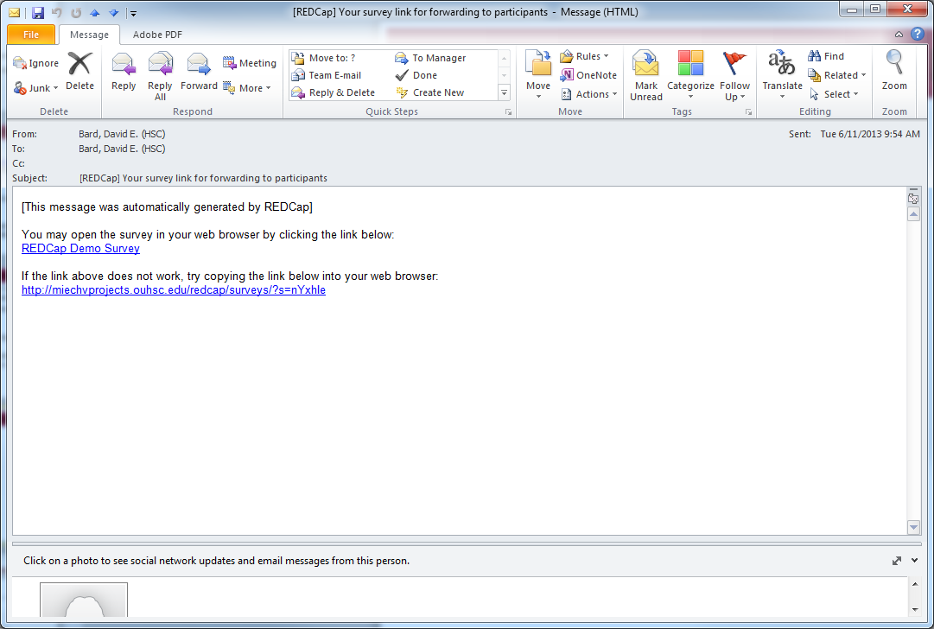
Example: Survey-based Data Entry

Slide 13
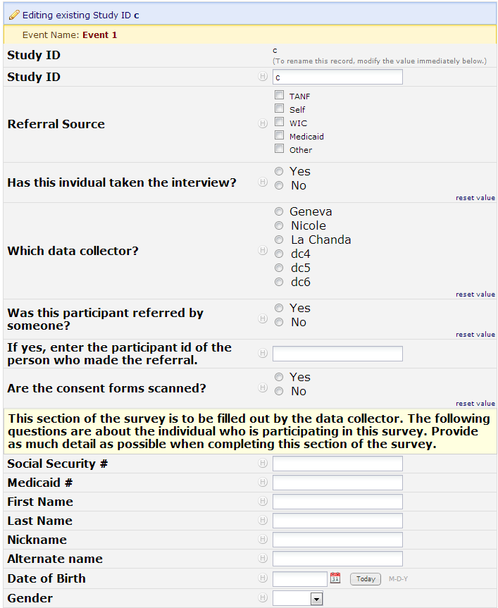
Example Form-based Data Entry

Slide 14
Thomas’ Data Entry Demonstration
Go to https://zzzzzzzzz.ouhsc.edu/
Login
Select project “testing123”
Enter some more test data
Create a calendar entry
(Note: the exact address has been changed for security purposes.)

Slide 15
Data Dictionary Demos
Can create an entire project by uploading pre-existing data dictionary .csv file
Click “My Projects” and select ‘DATAnalytics Core Demo: Data Dictionary Upload’
Click “Upload Data Dictionary” button and select dictionary file
Change existing field using data dictionary
Click “Project Setup” button, then “Upload Data Dictionary”
Select new dictionary file and “Commit Changes”
Add new fields using data dictionary
Same as change existing fields

Slide 16
Possible REDCap Workflows

Slide 17
Scenarios Favoring REDCap
Project requires a centralized data store, but multiple locations for data entry. - Avoid syncing different locations manually.
You want a flexible, universal framework to create consistent data systems for multiple clinical projects (research and possibly operations). - Reduces your development time & your staff’s training time. - Reduces writing new text for grant proposals and IRB?
Project has a relatively flat data structure.
Typically accommodates 2 or 3 levels well, but is clumsy beyond that. County, Practice, Provider, Patient, Time, Family.

Slide 18
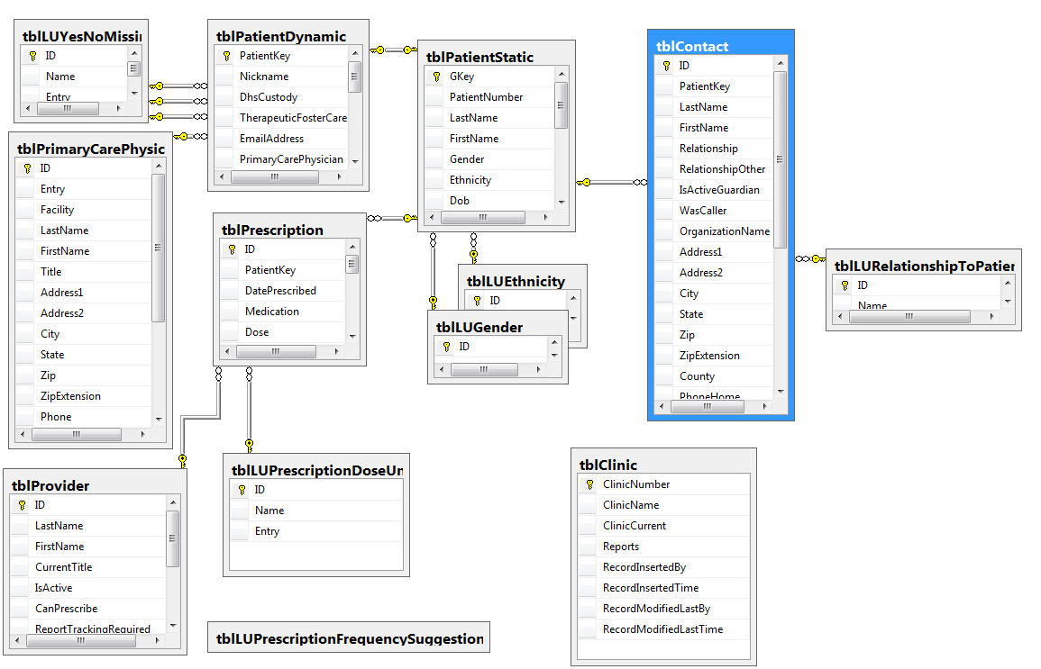
Scenario NOT favoring REDCap

Slide 19
Scenarios Favoring REDCap
No professional software developer on the project
There’s nothing magical about REDCap; it accommodates the designs and needs of many clinical projects.
To develop a comparable system from scratch, you’d need experience with several technologies.
There are lots of dimensions and trade-offs when designing clinical research, and REDCap is close to the sweet spot for most designs.
Candidate for replacing Access, Survey Monkey, Excel.

Slide 20
Project Management with REDCap
While the original intent of the development of REDCap was to provide researchers with a secure web application for research, a REDCap project can be designed to simultaneously aid in project management and productivity monitoring.

Slide 21
Productivity Monitoring
What do you want to monitor?
Productivity indicators can be incorporated in the original design phase of a REDCap project, or added to an existing project.

Slide 22
MIECHV Project Productivity Indicators
Community Survey Recruitment
Total recruitment calls made
Time spent on recruitment calls
Average time per recruiting call
Number of recruits who agreed to participate
Percent of recruits who agreed to participate
Community Surveying
Total interviews completed
Time spent conducting interviews
Average time per interview

Slide 23
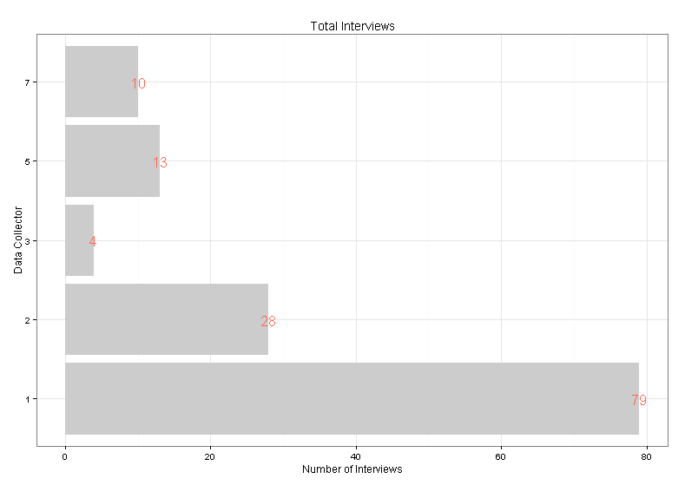
Example Report (Project Aggregate)

Slide 24
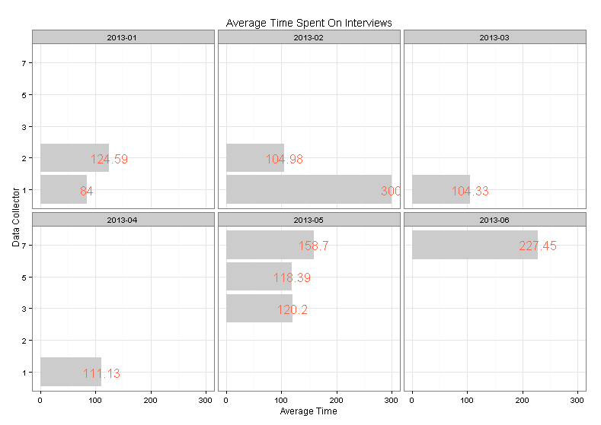
Example Report (6 Month History)

Slide 25
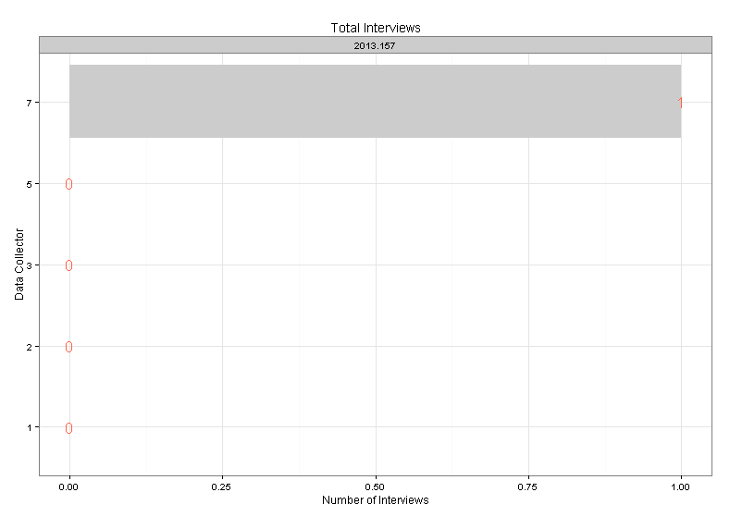
Example Report (7 Day History)

Slide 26
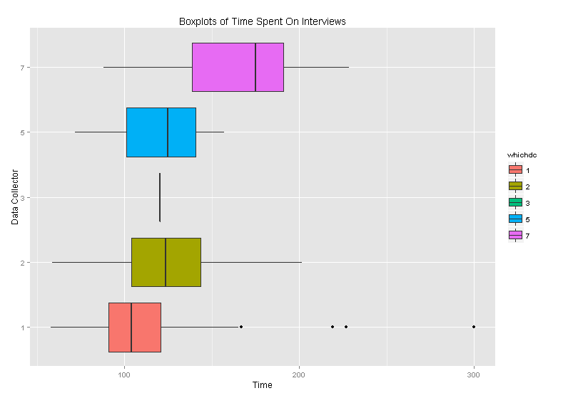
Example Report (Project Aggregate)

Slide 27
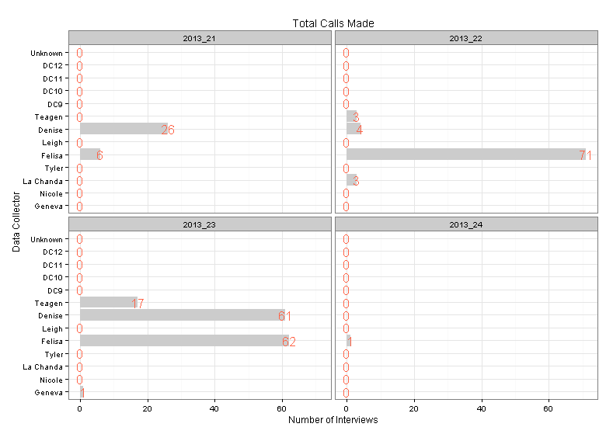
Example Report (4 Week History)

Slide 28
REDCap Advantages
Flexibility:
Productivity indicators established by project team
Reporting methods determined by project needs
All aspects are customizable
Current and historical reports
Automated:
Not necessary to compile data
Real-time data availability

Slide 29
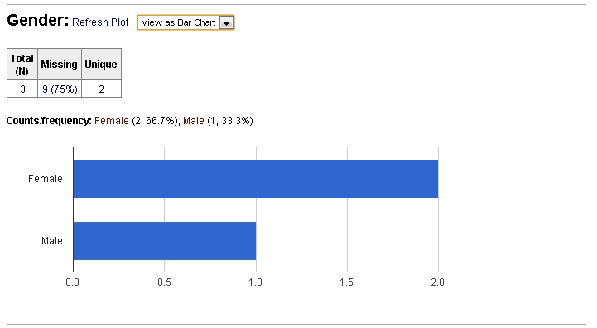
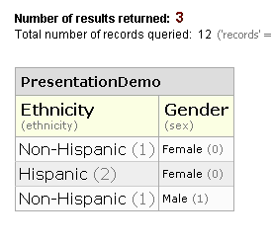
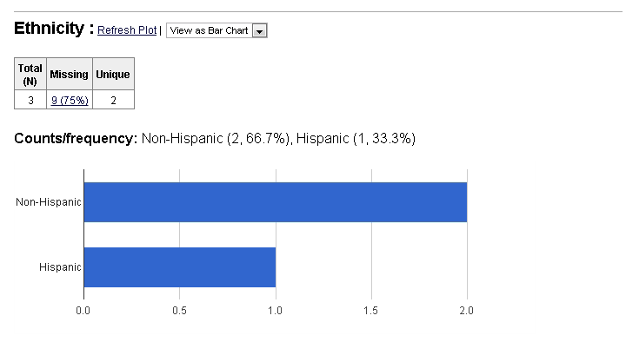
Reports for Outcomes: within REDCap
Accommodates basic descriptives & graphs, but not much more.

Slide 30
Reports for Outcomes: External to REDCap
Use automation to present results in a coherent document.
Eliminate the need to repeatedly copy & paste:
Multiple descriptives, graphs, and model results.
Updated results after more data trickles in.
Internal vs. External Audiences

Slide 31
Reports for Outcomes: Examples
Descriptives & graphs for internal audiences.
Tables for external audiences.
Text and Graphs for external audiences.
Optionally hosted online. https://github.com/OuhscCcanMiechvEvaluation/MReporting/blob/master/OhcaReports/OhcaReport1/OhcaReport1.md

Slide 32
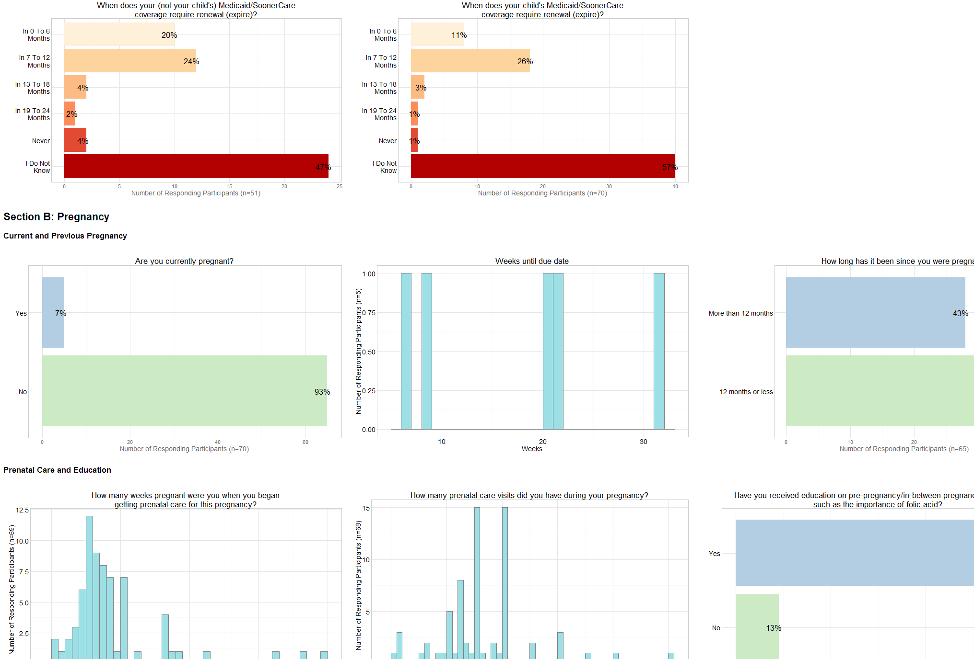
Quick for Internal Audiences

Slide 33
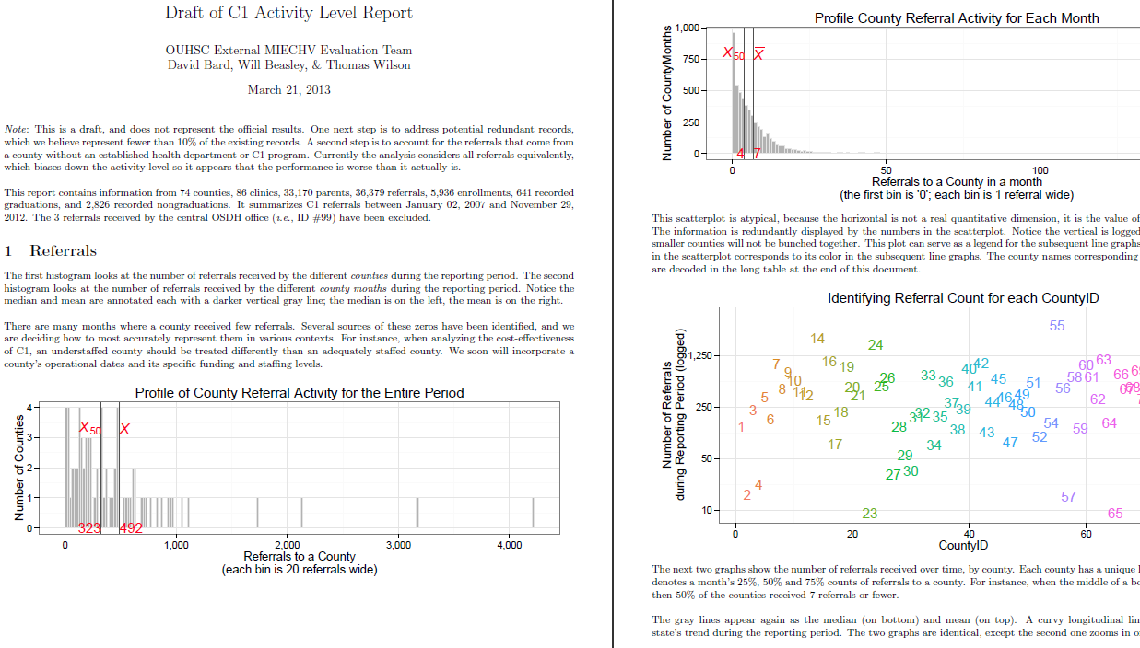
Text and Graphs for External Audiences

Slide 34
Text and Graphs for External Audiences

Slide 35
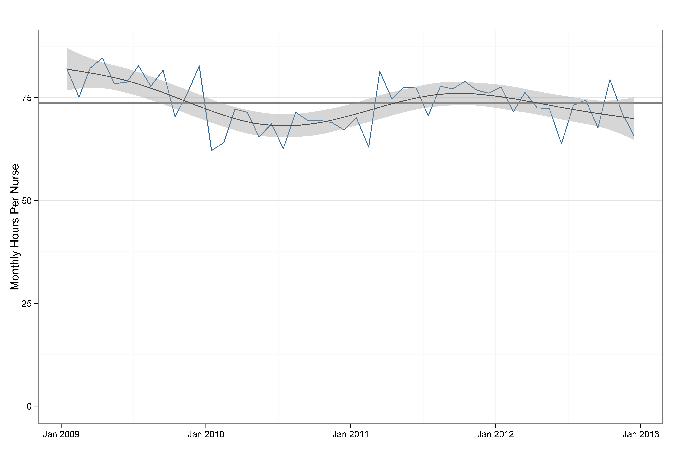
Text and Graphs for External Audiences

Slide 36
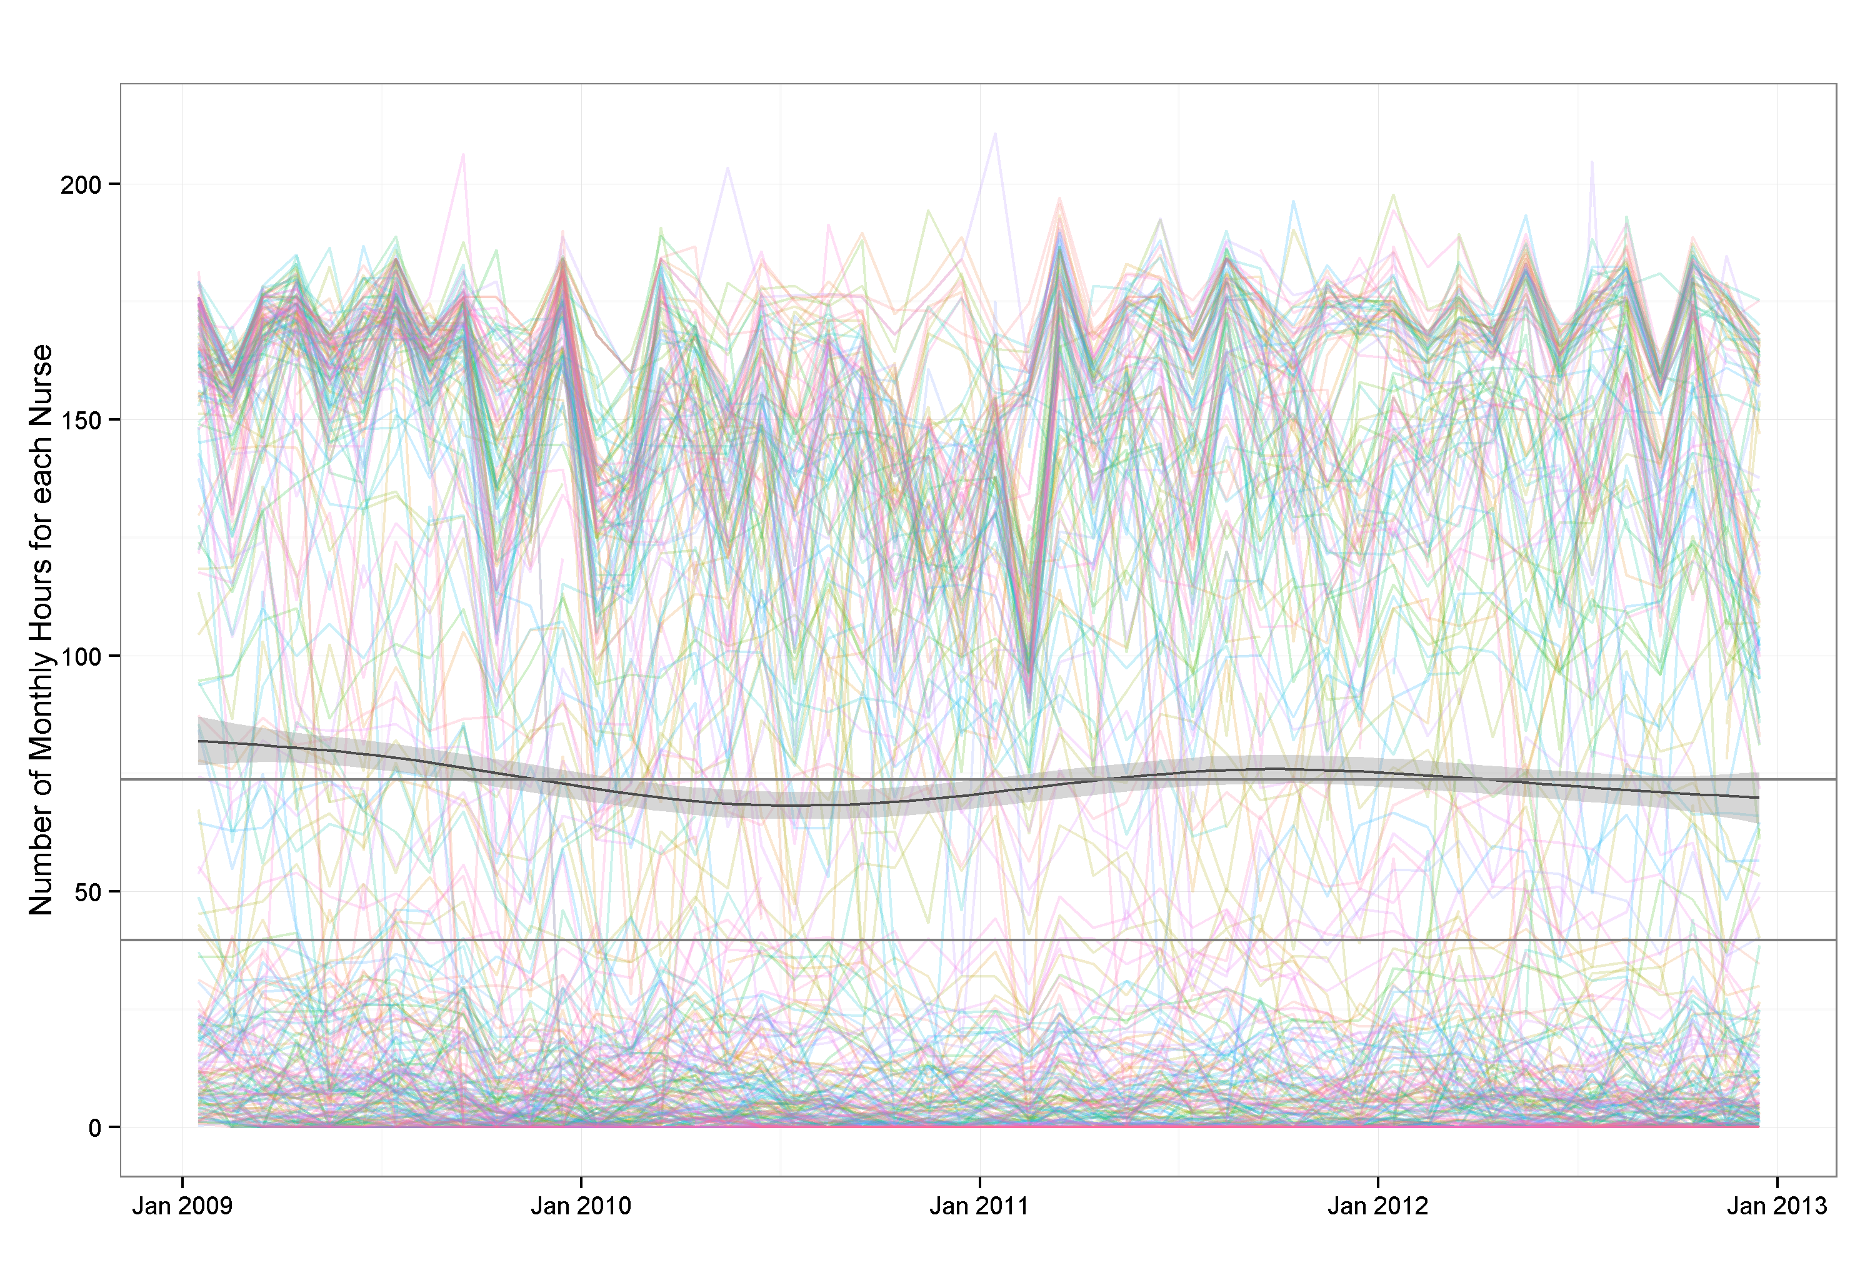
Text and Graphs for External Audiences

Slide 37
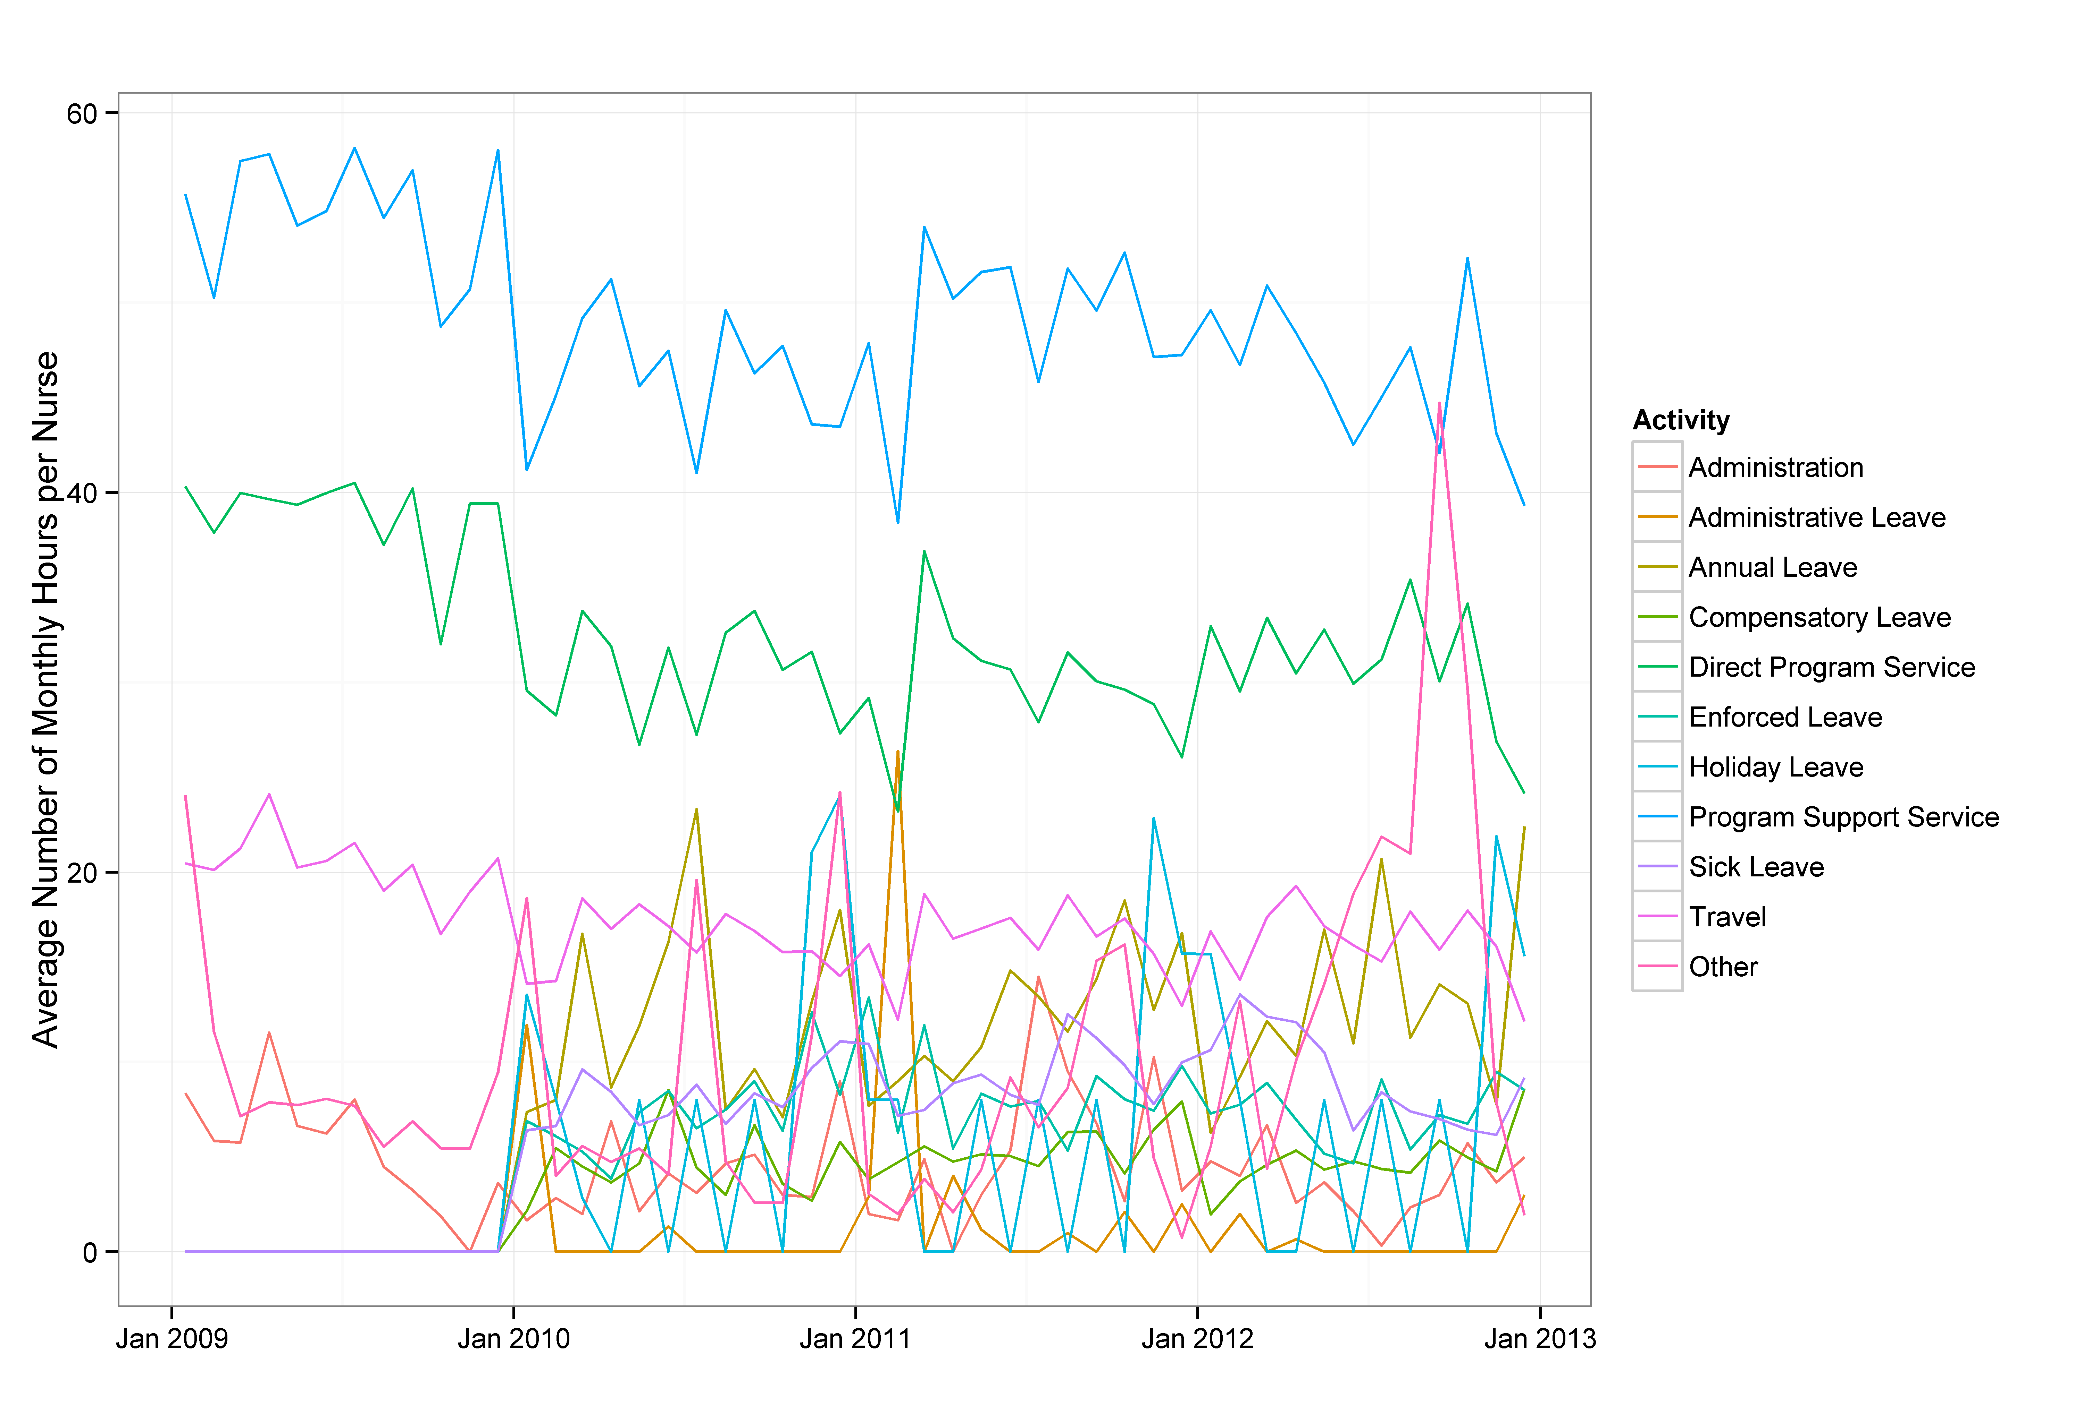
Text and Graphs for External Audiences

Slide 38
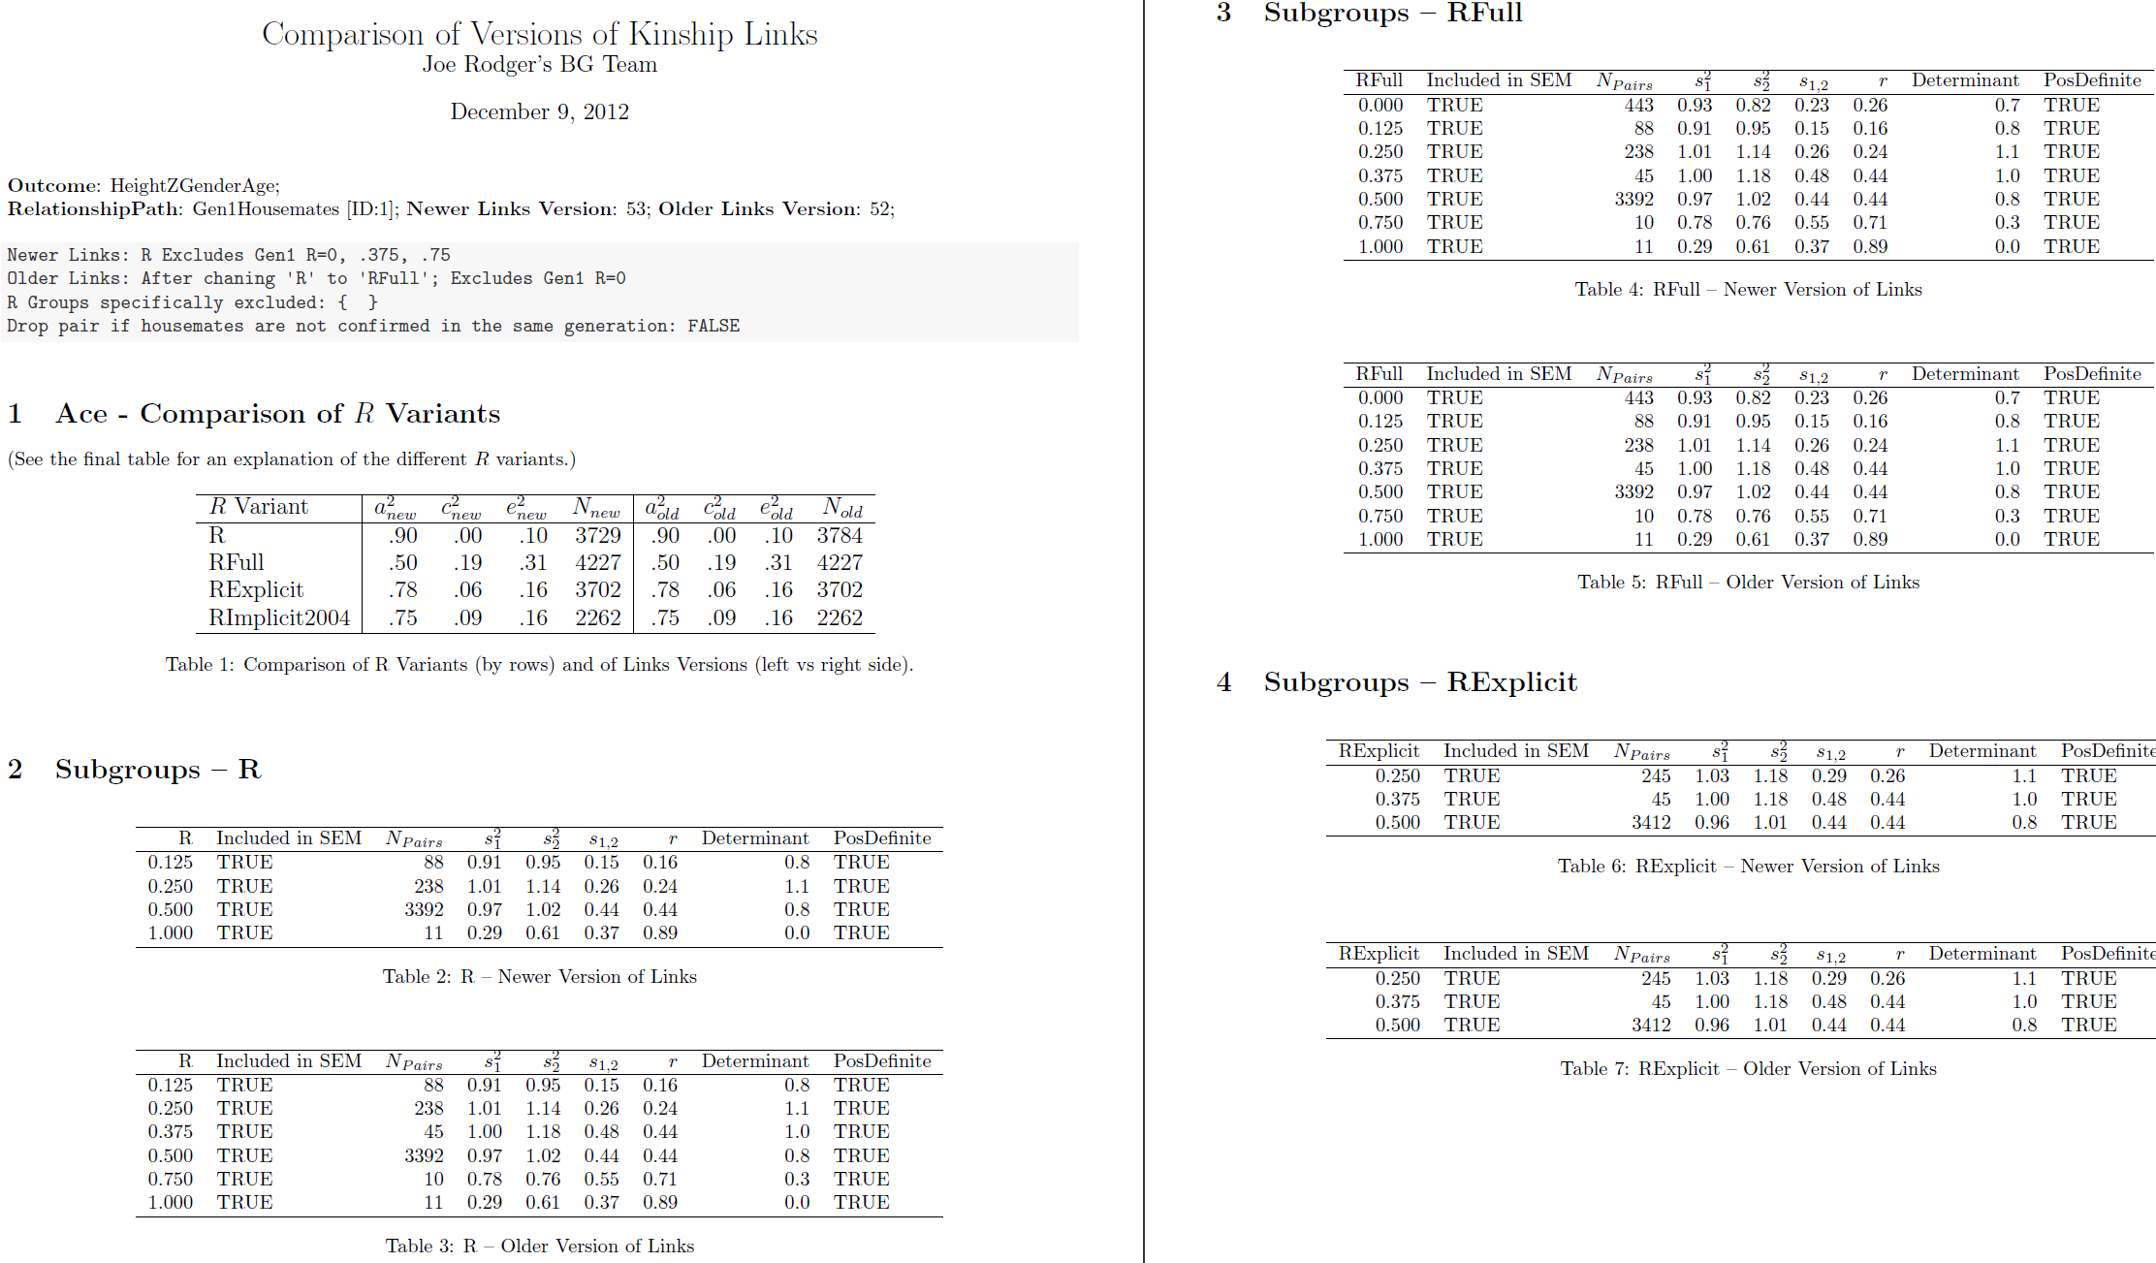
Tables for External Audiences

Slide 39
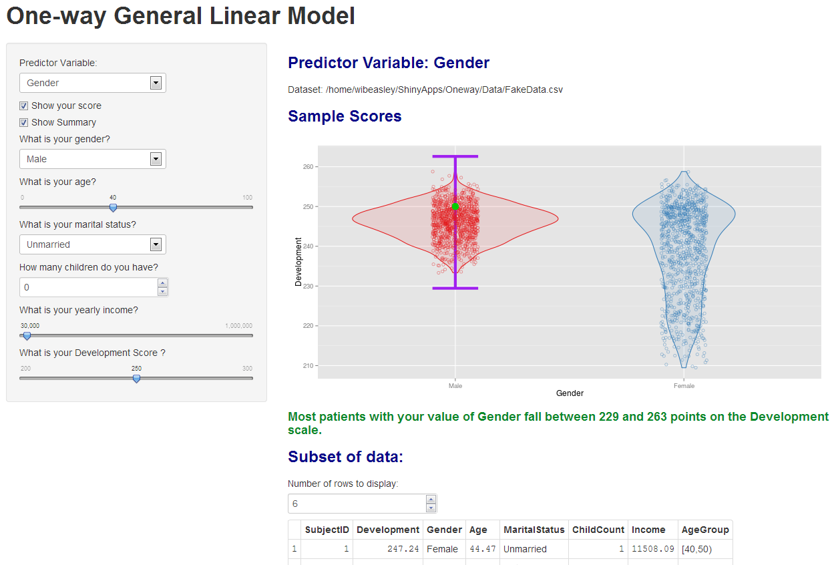
Quick for Internal Audiences

Slide 40
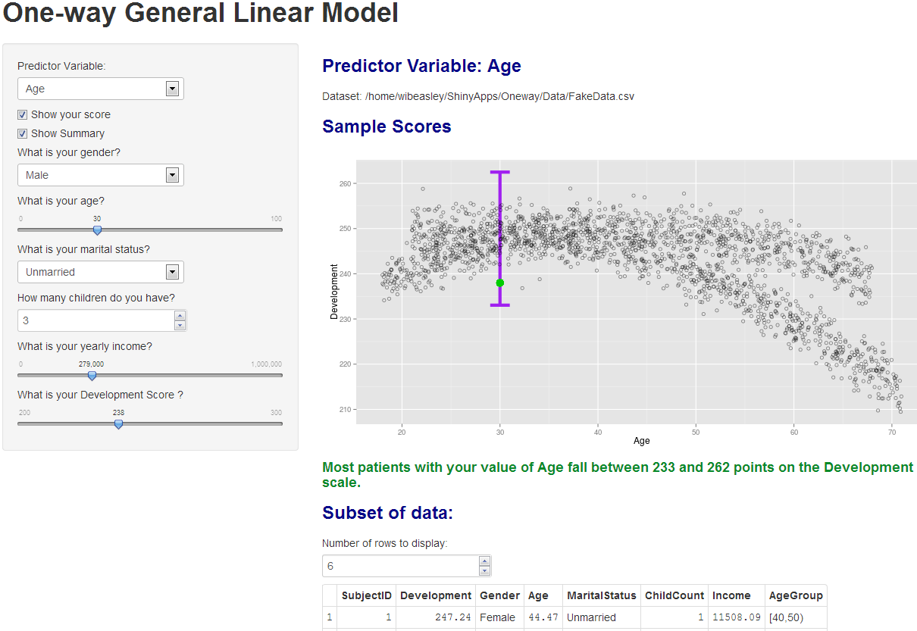
Quick for Internal Audiences

Slide 41
Goals
Reproducible research.
Facilitates scientific replication.
Disseminates techniques to other subfields.
Promotes cumulative research.
Literate programming.
Evaluated programs need fresh & frequent feedback.
Collaborative Development.

Slide 42
Collaboration among
The 4 statisticians on the project. sharing software development.
The 20 people on the project. exchanging participant-level data.
The 3 partnering organizations. (OSDH, WIC, OHCA) -receiving their subject-level & agency-level data. -distributing our results –fresh & frequently.
Academics in different areas. (particularly at OUHSC) exchanging tools and workflows.
Researchers in other states pursuing similar goals. publishing ideas and replicating previous work.

Slide 43
Accessing OUHSC REDCap
OUHSC REDCap website: https://miechvprojects.ouhsc.edu/redcap/BBMC/redcap.html
REDCap Overview
Access to REDCap
REDCap Login
Licensing
Compliance
Policy
Training and Learning Resources (Basic)
Training and Learning Resources (Advanced)
Getting Help
For More Information

Slide 44
Intro to Security Concepts
College of Medicine has devised a REDCap governance body to oversee data security concerns
In a nut-shell, looking to see if investigators and staff have proper IRB clearances for storing PHI on REDCap.
Will provide general advice on secure best practices
To gain access to REDCap, you must have seal of approval of this governance body
Please visit REDCap website to initiate request and review security policies and procedures under Compliance links
https://miechvprojects.ouhsc.edu/redcap/BBMC/redcap.html
After request is initiated, the REDCap Appropriate Use Policy must be reviewed and the REDCap Data Use Agreement must be signed (BBMC will circulate after request is made)
https://miechvprojects.ouhsc.edu/redcap

Slide 45
Underlying Security Concepts Part 1
Principle of least privilege: expose as little as possible.
Limit the number of team members.
Limit the amount of data (consider rows & columns).
Obfuscate values and remove unnecessary PHI in derivative datasets.
Redundant layers of protection.
A single point of failure shouldn’t be enough to breach PHI security.

Slide 46
Underlying Security Concepts Part 2
Simplify when possible.
Store data in only one or two places. (REDCap & SQL Server)
Easier to identify & manage than a bunch of PHI CSVs scattered across a dozen folders, with versions.
Manipulate your data programmatically, not manually.
Windows AD account controls everything, indirectly or directly. (VPN, Odyssey, file server, SQL Server, & REDCap)
Lock out team members where possible. It’s not that you don’t trust them with a lot of unnecessary data, it’s that you don’t trust their ex-boyfriend and their coffee shop hacker.

Slide 47
The design of the project is as follows:
Simplify when possible.
Store data in only two houses. (REDCap & SQL Server)
Easier to identify & manage than a bunch of PHI CSVs scattered across a dozen folders, with versions.
Manipulate your data programmatically, not manually.
Windows AD account controls everything, indirectly or directly. (VPN, Odyssey, file server, SQL Server, & REDCap)
Lock out team members where possible. It’s not that you don’t trust them with a lot of unnecessary data, it’s that you don’t trust their ex-boyfriend and their coffee shop hacker.

Slide 48
SOPs and Documenting Projects in REDCap
Standard Operating Procedures (SOPs)
The different phases considered in the development of a project are aligned with REDCap:
Initiation
Development
Production
Conclusion
Archival

Slide 49
SOPs and Documenting Projects in REDCap
The major actions regulated and documented are:
Request a new project
Project definition
Letter of collaboration and agreement
Validation testing
User account request
Training log
Change Project definition
Platform transfer specifications
Data sharing
Database closure
Decommissioning

Slide 50
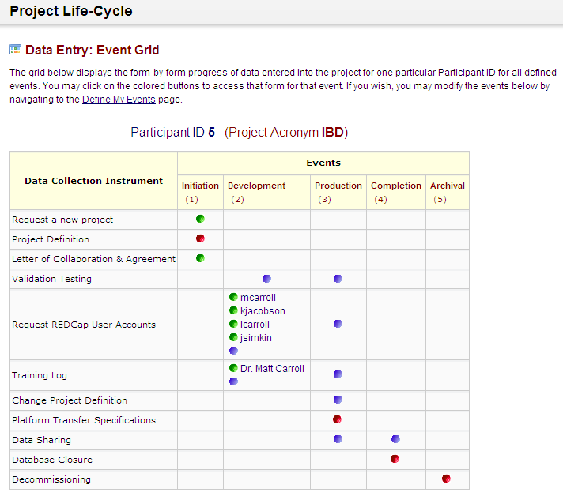
The design of the project is as follows:
Phases
Actions

Slide 51
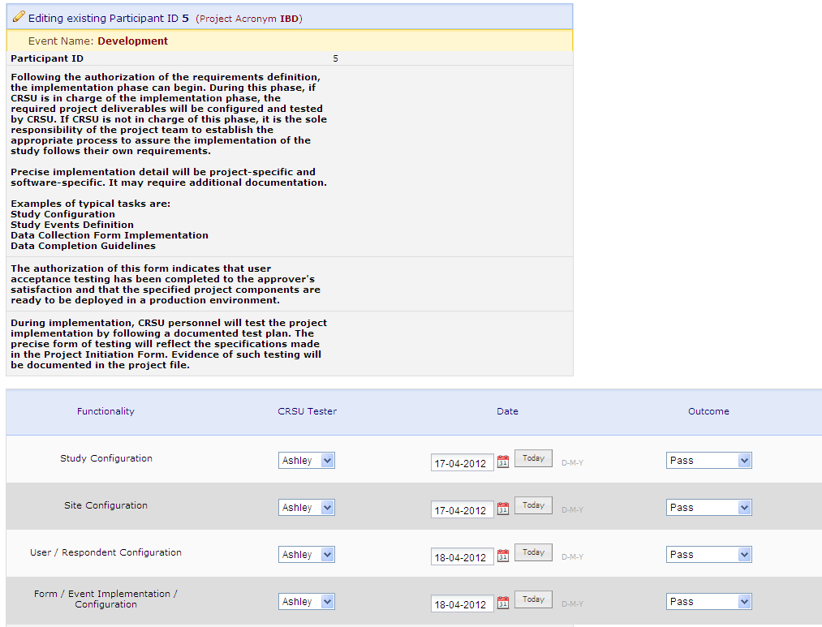
SOPs and Project Development
Instructions
Documentation

Slide 52
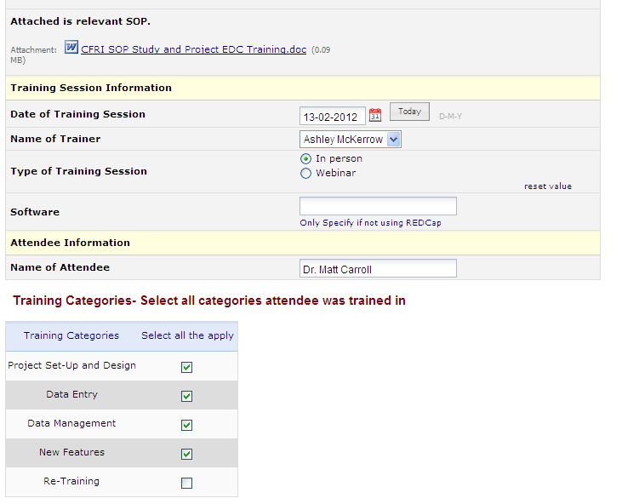
SOPs and Training
SOP
Documenting
Training

Slide 53
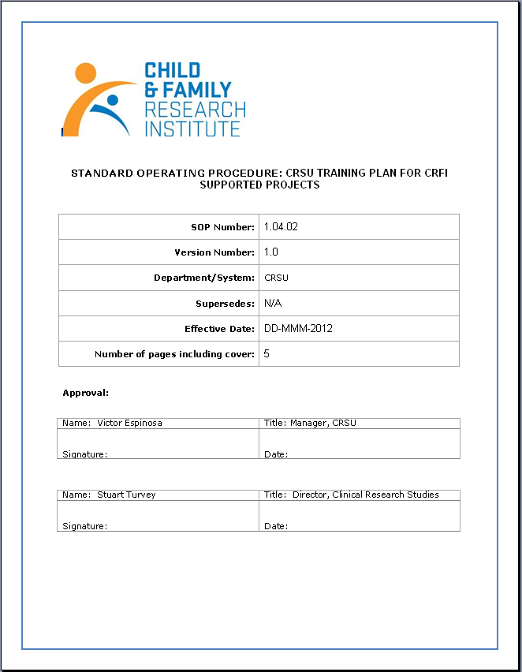
SOPs and Training
Version
control

Slide 54
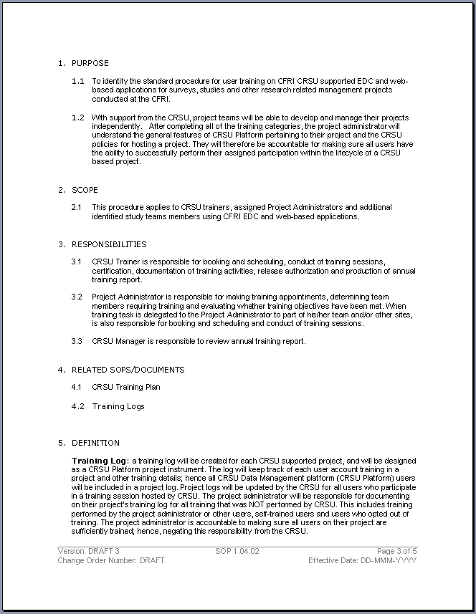
SOPs and Training
Purpose
Scope
Responsibilities
Definitions

Slide 55

SOPs and Training
Procedure
(types of training)

Slide 56
Citing REDCap in Grants/IRB
How should I describe REDCap in grant or IRB applications?
Data for this study will be entered into REDCap, a database software system developed by Vanderbilt University for electronic collection and management of research and clinical trial data. REDCap uses a MySQL database via secure web interface with data checks used during data entry to ensure data quality. REDCap includes a complete suite of features to support HIPAA and FERPA compliance, including a full audit trail, user-based privileges, and integration with the institutional LDAP server. REDCap also enables automated export mechanism to common statistical packages (SPSS, SAS, Stata, R/S-Plus), simultaneous multi-user and multi-site access, full control over individual-level data access permissions, and remote survey and form-based data capture methods. REDCap technical support is provided by the Biomedical and Behavioral Methodology Core of the Department of Pediatrics, College of Medicine. The MySQL database and the web server will both be housed on secure servers operated by the University of Oklahoma Health Sciences Center Information Technology. The servers are in a physically secure data center on campus and are backed up nightly, with backups stored in accordance with the OUHSC IT schedule of daily, weekly, and monthly tape retentions of 1 month, 3 months, and 6 months, respectively. Weekly backup tapes are stored offsite. The OUHSC IT servers provide a stable, secure, well-maintained high-capacity data storage environment, and both REDCap and MySQL are widely-used, powerful, reliable, well-supported systems. Access to the study’s data in REDCap will be restricted to the members of the study team by username and password.

Slide 57
Citing REDCap in Manuscripts
How should I cite REDCap in study manuscripts?
Study data were collected and managed using REDCap electronic data capture tools hosted at the University of Oklahoma Health Sciences Center.¹ REDCap (Research Electronic Data Capture) is a secure, web-based application designed to support data capture for research studies, providing: 1) an intuitive interface for validated data entry; 2) audit trails for tracking data manipulation and export procedures; 3) automated export procedures for seamless data downloads to common statistical packages; and 4) procedures for importing data from external sources.
¹ Paul A. Harris, Robert Taylor, Robert Thielke, Jonathon Payne, Nathaniel Gonzalez, Jose G. Conde, Research electronic data capture (REDCap) - A metadata-driven methodology and workflow process for providing translational research informatics support, J Biomed Inform. 2009 Apr; 42(2): 377-81. Link to article: http://dx.doi.org/10.1016/j.jbi.2008.08.010

Slide 58
Thank You!
Comments or Questions???

Slide 59
Feature | REDCap | Qualtrics
Data Dictionary | Y | ?
Data Import | Y | n
Data Export & Summaries | Y | Y
E-mail survey | Only using a survey form, not a data collection form. | Y
Copy other surveys | Y | n
Survey templates | n | Y
Branching logic | Branching logic for individual Qs. | Branching for individual Qs and for groups of Qs.
Audio capabilities | Done via html | ?
Expiration capabilities: (eg, 1 week to respond) | n | Y
Spell check | n | Y
API | Y | n
Free to academic institutions | Y | n?
Offline data capture | Currently, there is not an official REDCap offline data capture component. However, CCAN has created an "in-house" off-line version of REDCap that is currently in use.
Our exposure to Qualtrics is limited. Please don’t interpret this as the authoritative guide.

